Slide 1
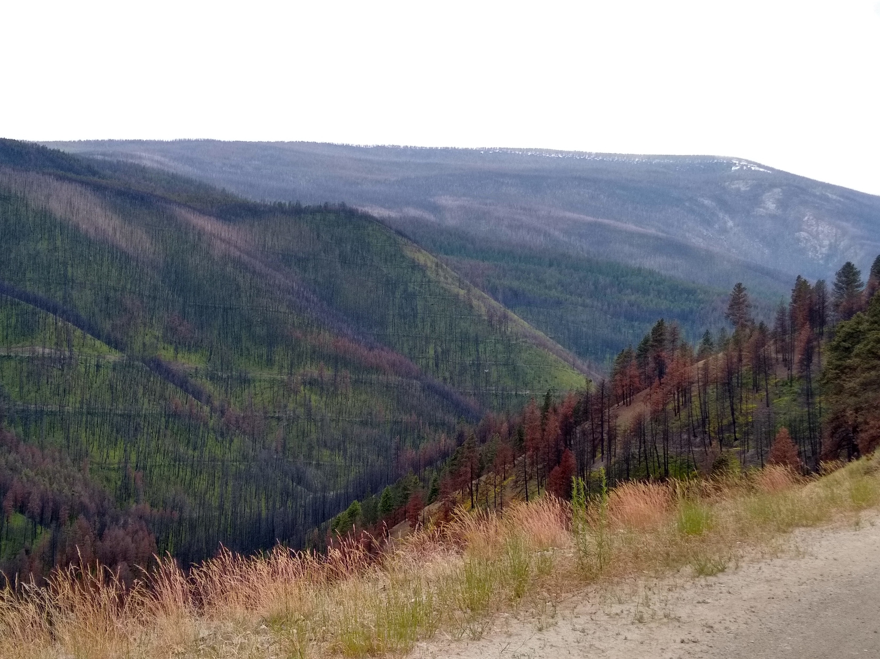
Hydrologic modeling applications in wildfire management
Zack Holden – Research Ecologist, RMRS Fire lab, Missoula, MT
Allen Warren – U. Montana
Alan Swanson– U. Montana
Kimberley Davis – RMRS Fire Lab
Solomon Dobrowski – U. Montana
Marco Maneta – U. Montana
Matt Jolly RMRS firelab
Charlie Luce RMRS, Boise
Kelsey Jencso, U. Montana
Zachary Hoylman, U. Montana
Ellen Jungck, USFS Region 1
Vince Archer, USFS Region 1
Lolo Peak fire, July-August 2017

Slide 2
Fire management space
1980’s climate
weather/climate
terrain
fuels/vegetation

Slide 3
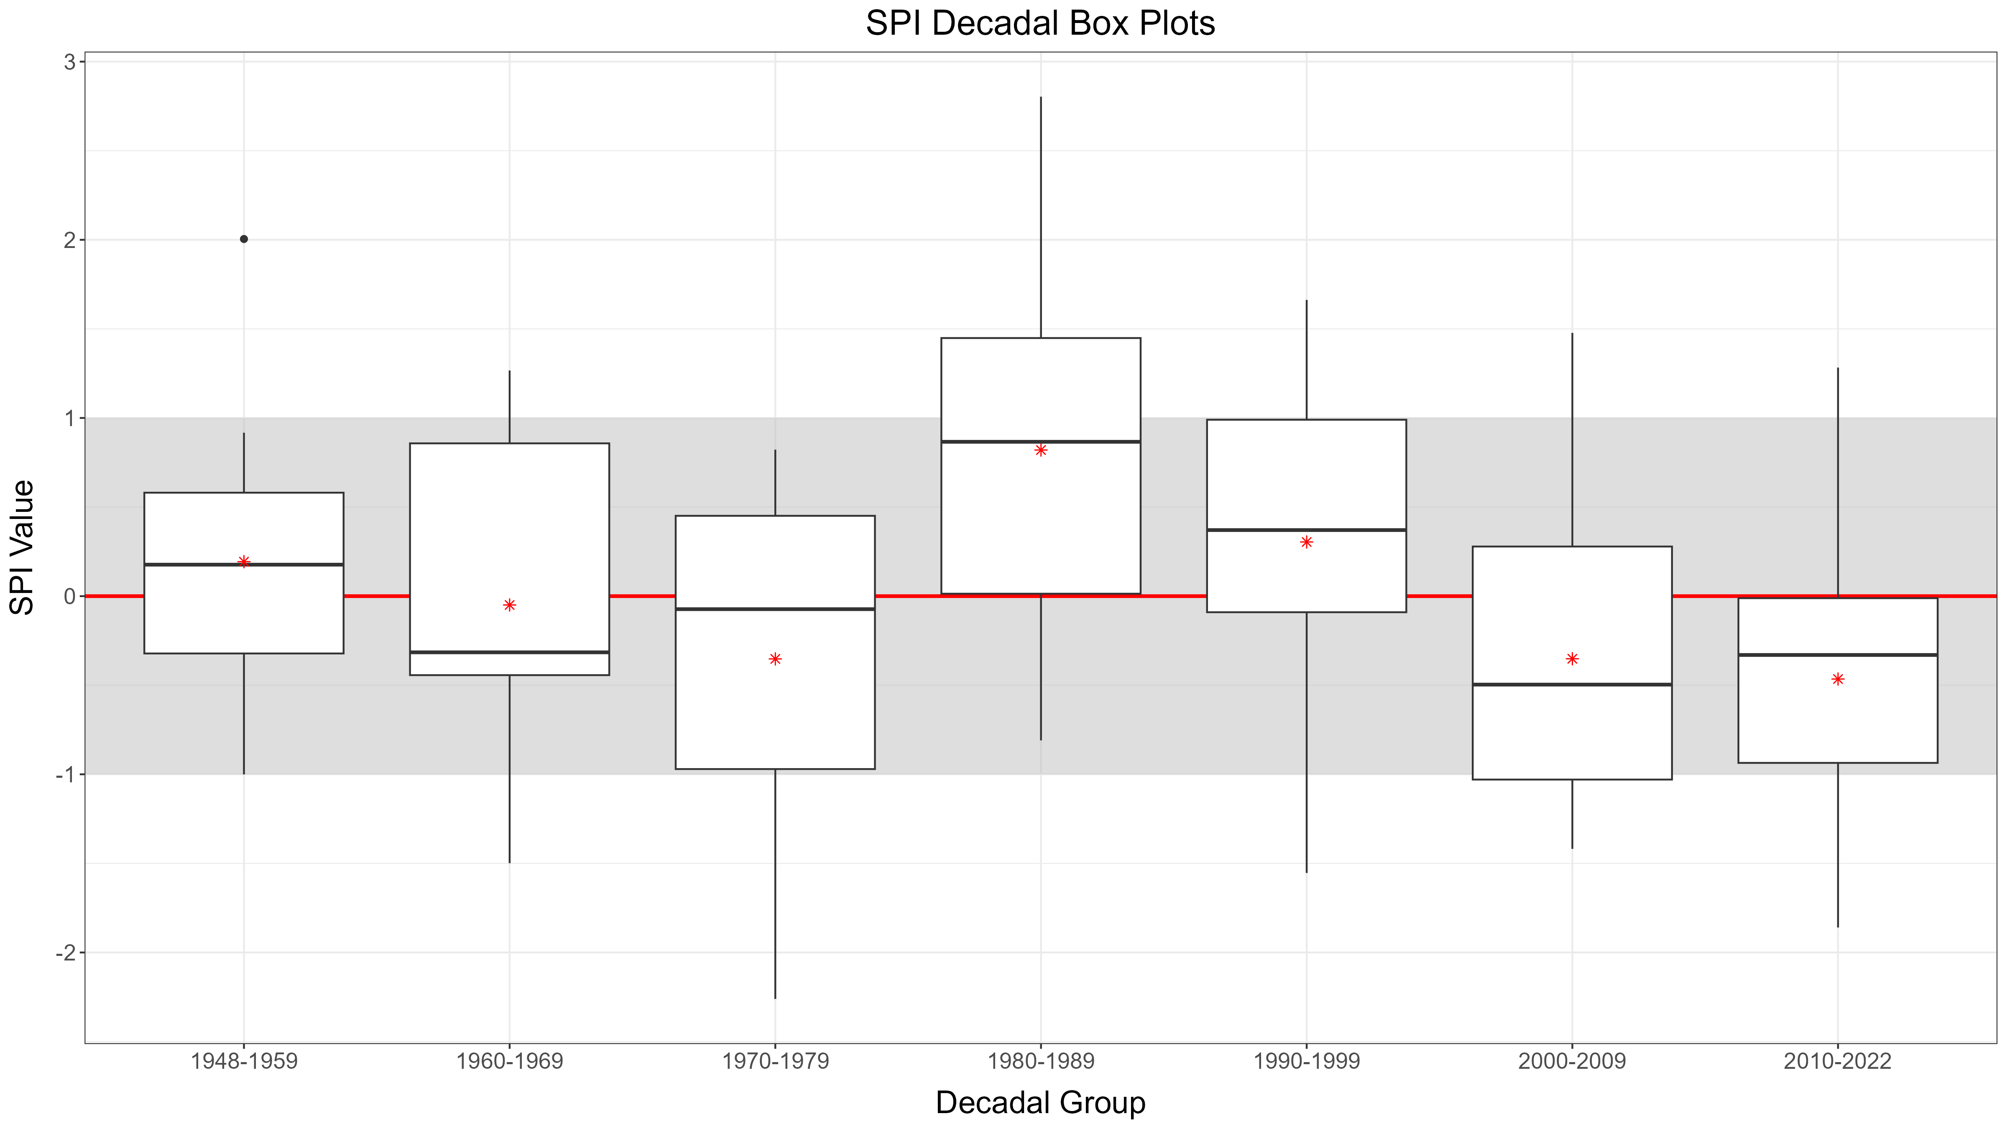
Nez Perce Clearwater Priority Landscape historical precipitation
Warm season (may-sept) standardized precipitation index (SPI)
DRY WET

Slide 4
Drought, climate change and extreme weather shrink weather windows for managing fire
Current/future climate
weather/climate
terrain
Drought
Climate change
Weather extremes
Challenging conditions
-Longer fire seasons
-Higher atmospheric aridity/temperature
-Less summer precipitation
-Longer periods without rain
-Drier fuels
-Fewer days meeting burn prescriptions
Fuels/vegetation

Slide 5
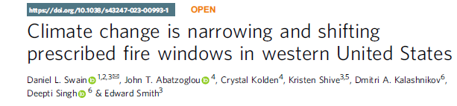
Drought, climate change and extreme weather shrink weather windows for managing fire
Current/future climate
weather/climate
terrain
Drought
Climate change
Weather extremes
Challenging conditions
-Longer fire seasons
-Higher atmospheric aridity/temperature
-Less summer precipitation
-Longer periods without rain
-Drier fuels
-Fewer days meeting burn prescriptions
Fuels/vegetation

Slide 6
Climate feedbacks to vegetation increase fuel complexity and hazard
weather/climate
Drought
Climate change
Weather extremes
terrain
More dynamic, complex fuels
More dead biomass
Western forests adapted to wet periods of the 1980’s-90’s are still responding to the last decade of drought.
-trees vulnerable to insects/disease
-Increased tree mortality
-more dead surface fuel
Fuels/vegetation

Slide 7
precision agriculture principals to deal with shrinking operating space?
weather/climate
high resolution
forecasts
terrain
microclimate
Precision fuel moisture
and temperature model
Precision silviculture
LiDAR, 3D fuel maps
Fuels/vegetation

Slide 8
precision agriculture principals to deal with shrinking operating space
weather/climate
high resolution
forecasts
terrain
microclimate
Precision fuel moisture
and temperature model
Hydrology
Vegetation stress, live
Fuel moisture content
Precision silviculture
LiDAR, 3D fuel maps
Fuels/vegetation

Slide 9

Review Findings
Insufficient consideration of the impact of long-term drought on prescribed fire behavior.
Not using available forecasting tools or insufficient training in using them.

Slide 10
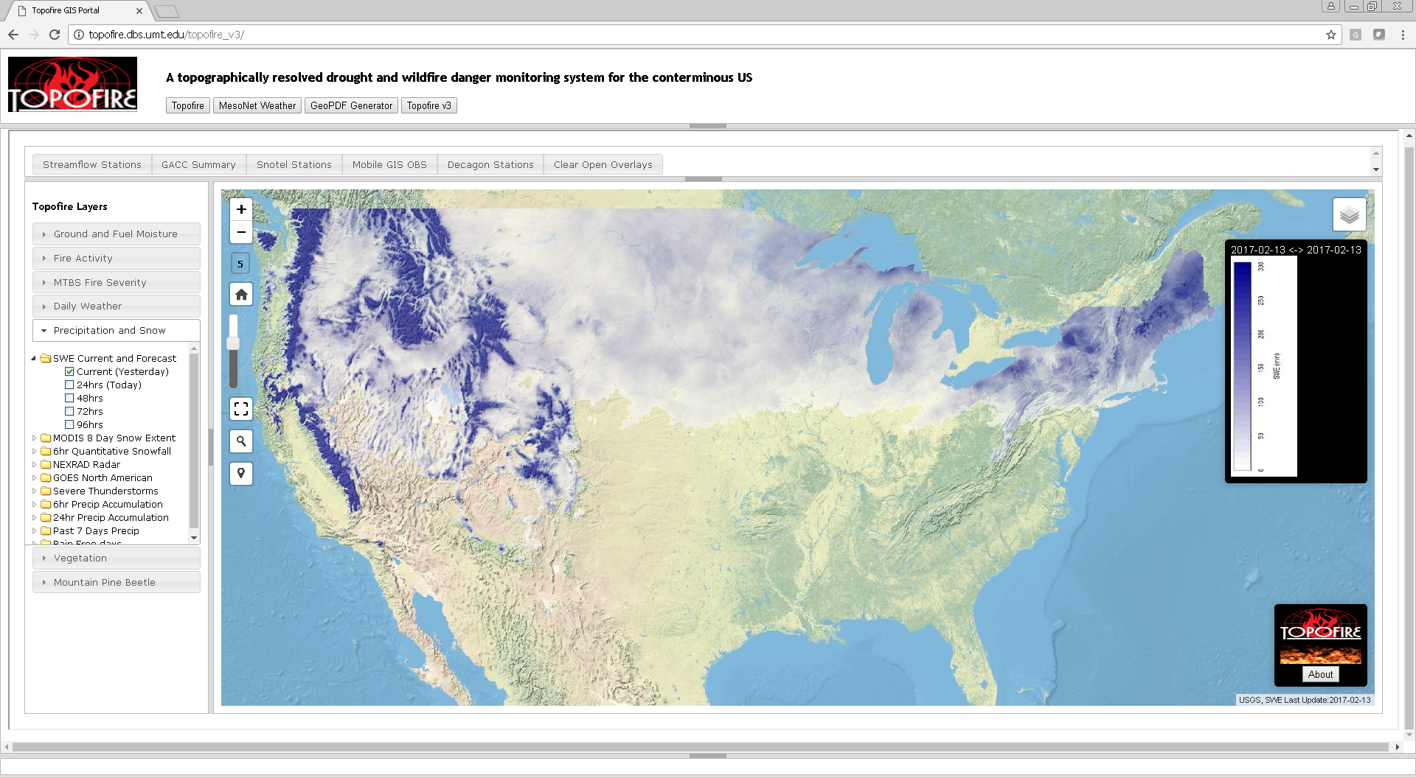


stopped running in 2020
NASA A.35 Applied Science / Wildfire Applications (2014-2018)
Co-PI’s Matt Jolly, Russ Parsons, Marco Maneta, Erin Landguth
Allen Warren
Alan Swanson
U. Montana

Slide 11
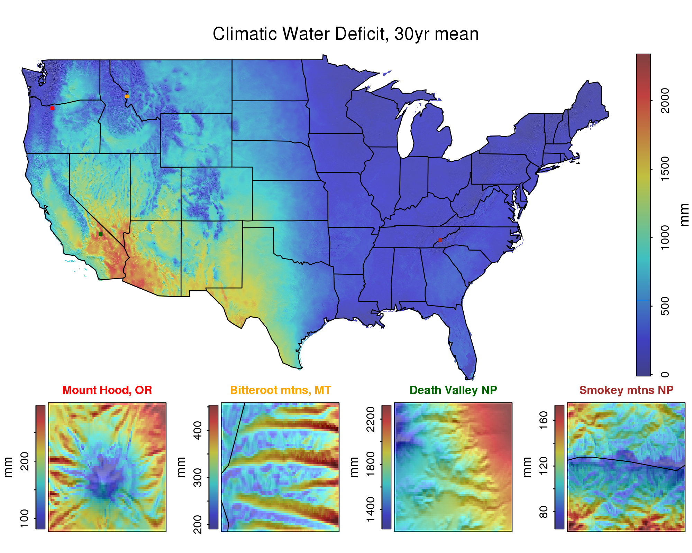
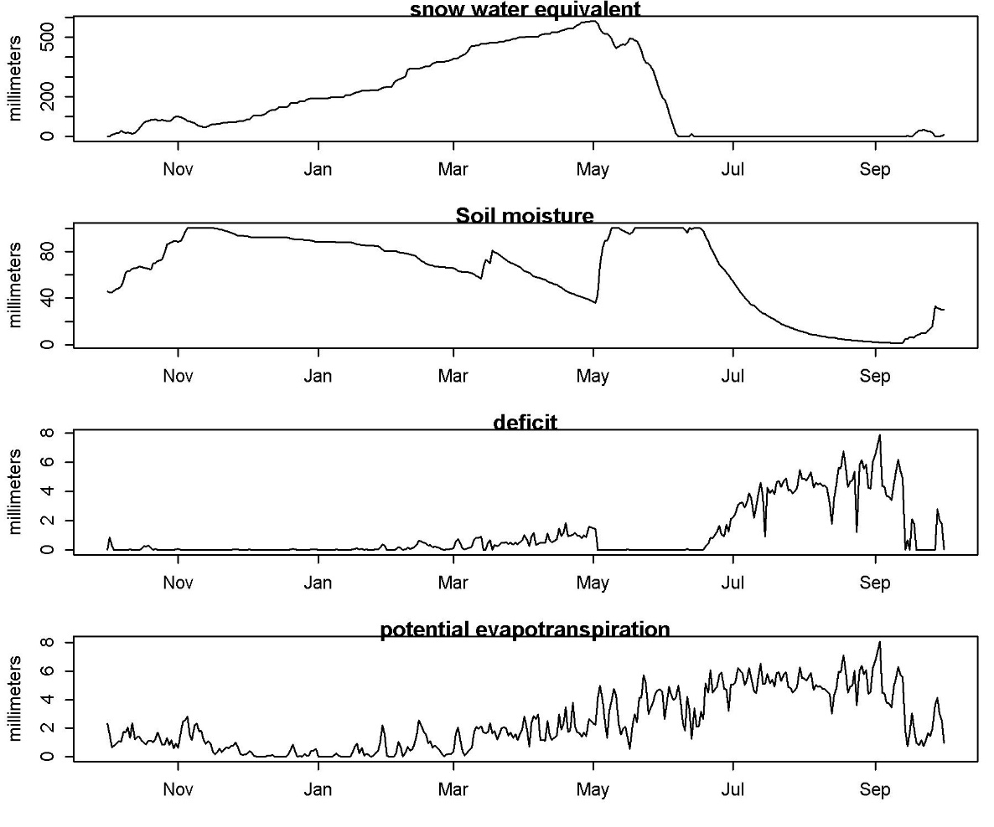
Historical soil water balance data
Daily 250 meter grids 1981-2020
30 year climatology/downscaled to 30m for Region 1
Vegetation mapping, modeling
Lolo, Montan 2017

Slide 12
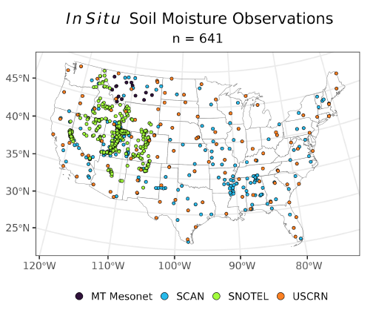
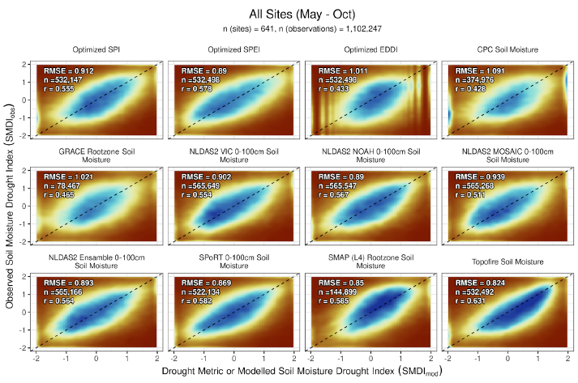

Zack Hoylman
U. Montana
Hoylman et al. (in revision) Optimizing drought assessment for soil for moisture deficits (Water Res. Res.)
NOAA/NIDIS funding-2018-2021; drought indicators of soil moisture

Slide 13
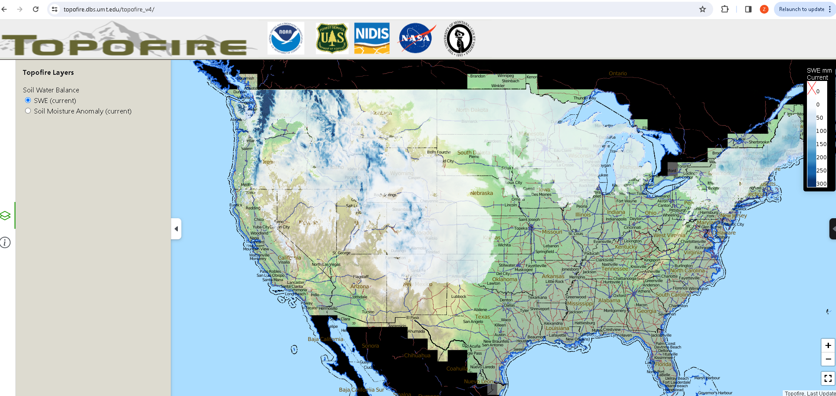
NOAA/NIDIS support 2021-2024
High resolution soil moisture modeling for drought an wildfire management
Marina Skumanich, Britt Parker

Slide 14
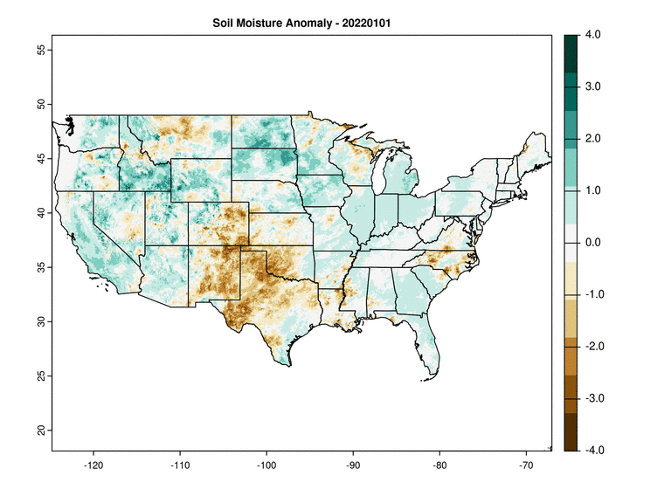
NOAA/NIDIS support 2021-2024 -Operational daily snow and soil moisture model
- Daily 250 meter soil moisture anomaly + 3 day forecast
- modified Keetch-Byram Drought Index in development (co-I Matt Jolly)
- planned link to drought.gov
Notes:
Use cartoon table to show how I measure things.

Slide 15

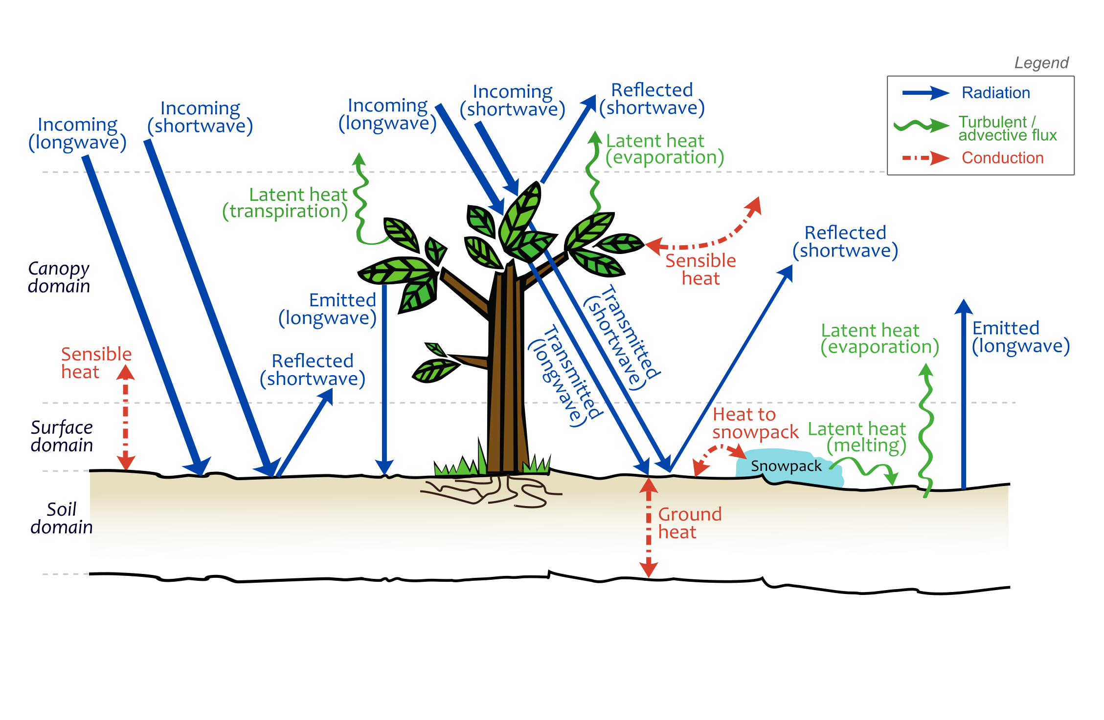

Ecohydrology models
Simulate surface energy/moisture exchange
-Ground surface temperature
-Soil moisture (3 layers)
-Ground temperature
- Evapotranspiration
~ Runoff (ech2o)
Frankenstein and Koenig 2004
Maneta and Silverman 2013

Slide 16



Solomon Dobrowski
Marco Maneta
National Science Foundation Geography Grant: Solomon Dobrowski, P.I. (2017-2019)
Anna Sala

Slide 17
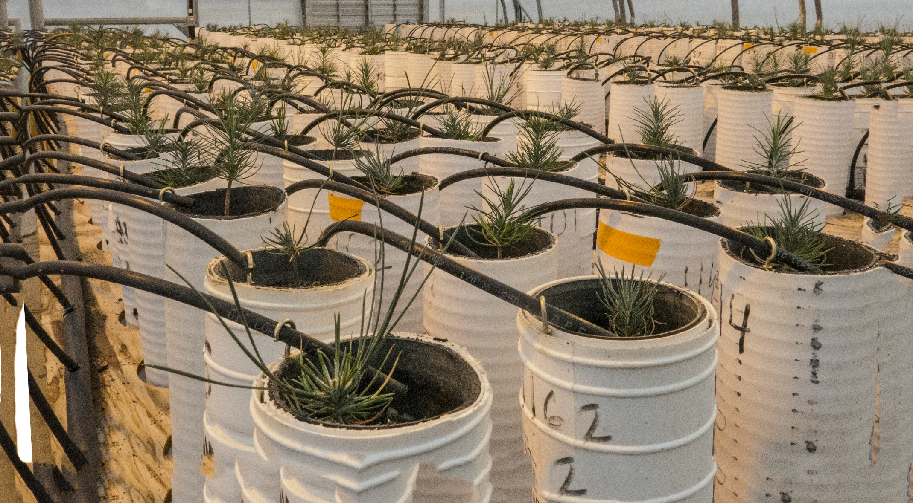

Simulating plant hydraulics with ech2o
Gerard Sapes, Anna Sala, University of Montana
Ponderosa pine seedling dry down Experiments

Slide 18
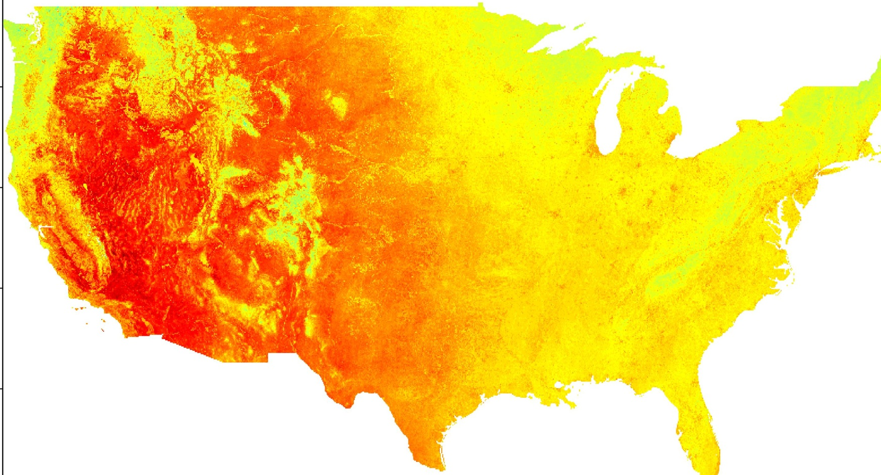
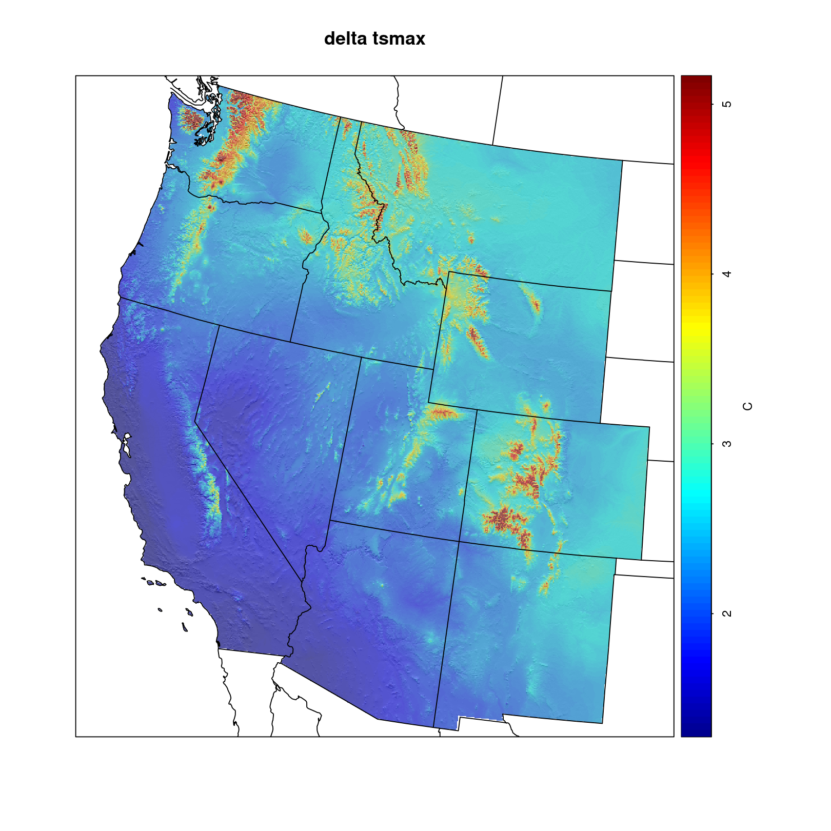
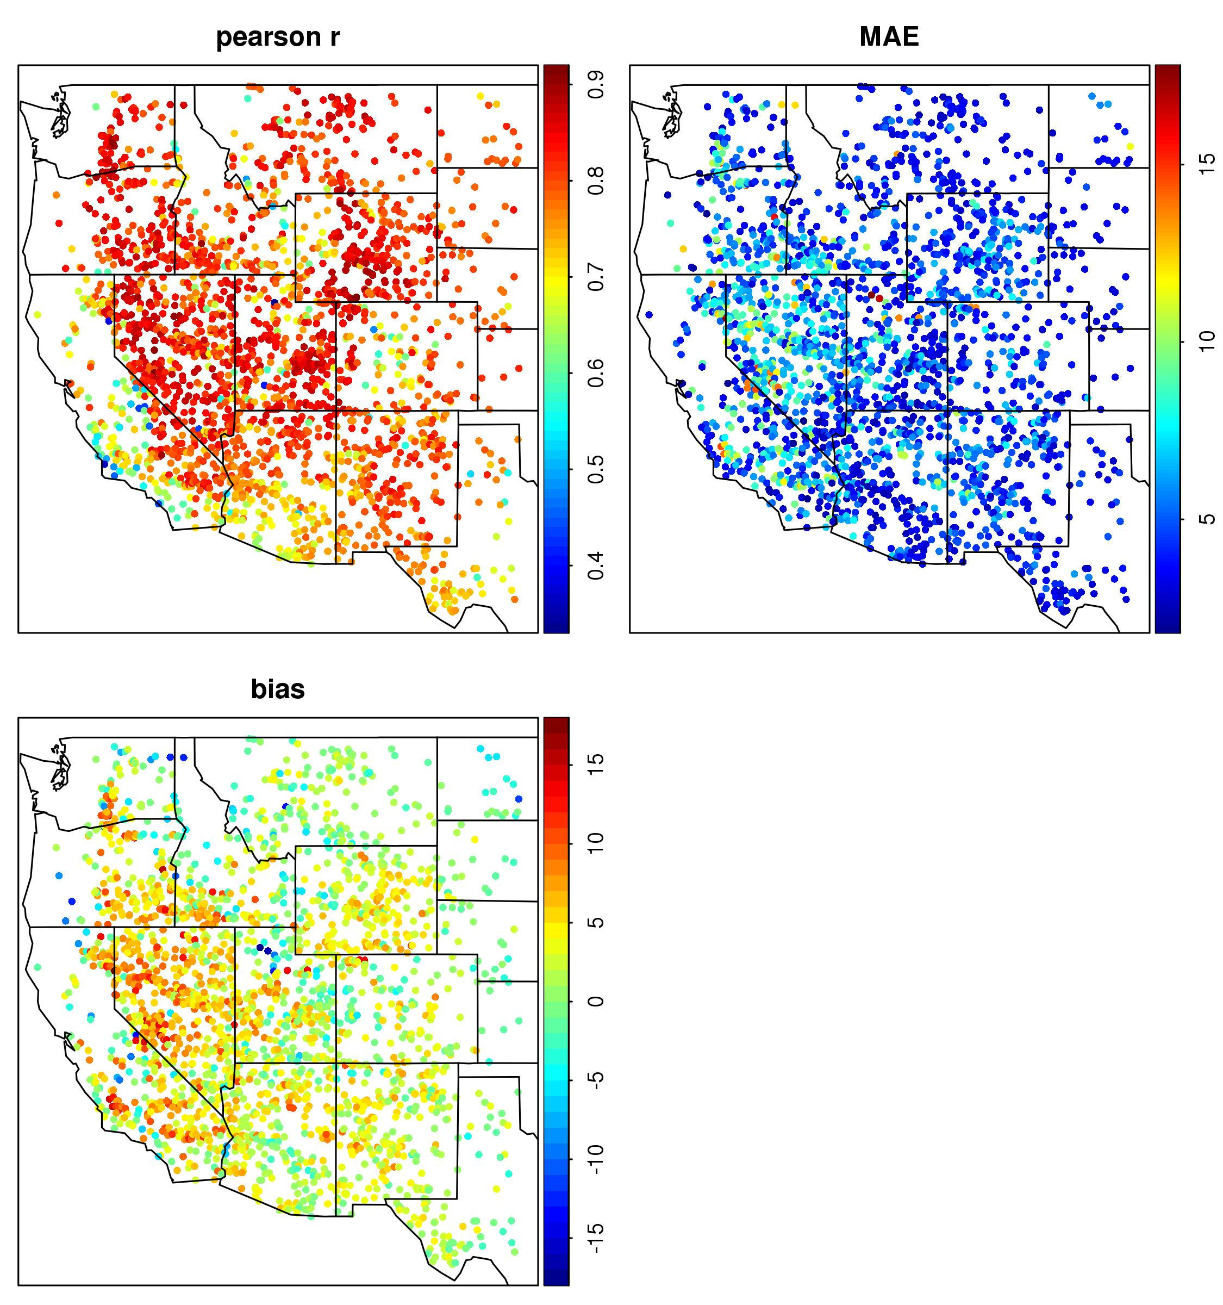
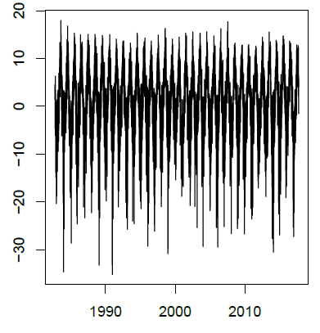
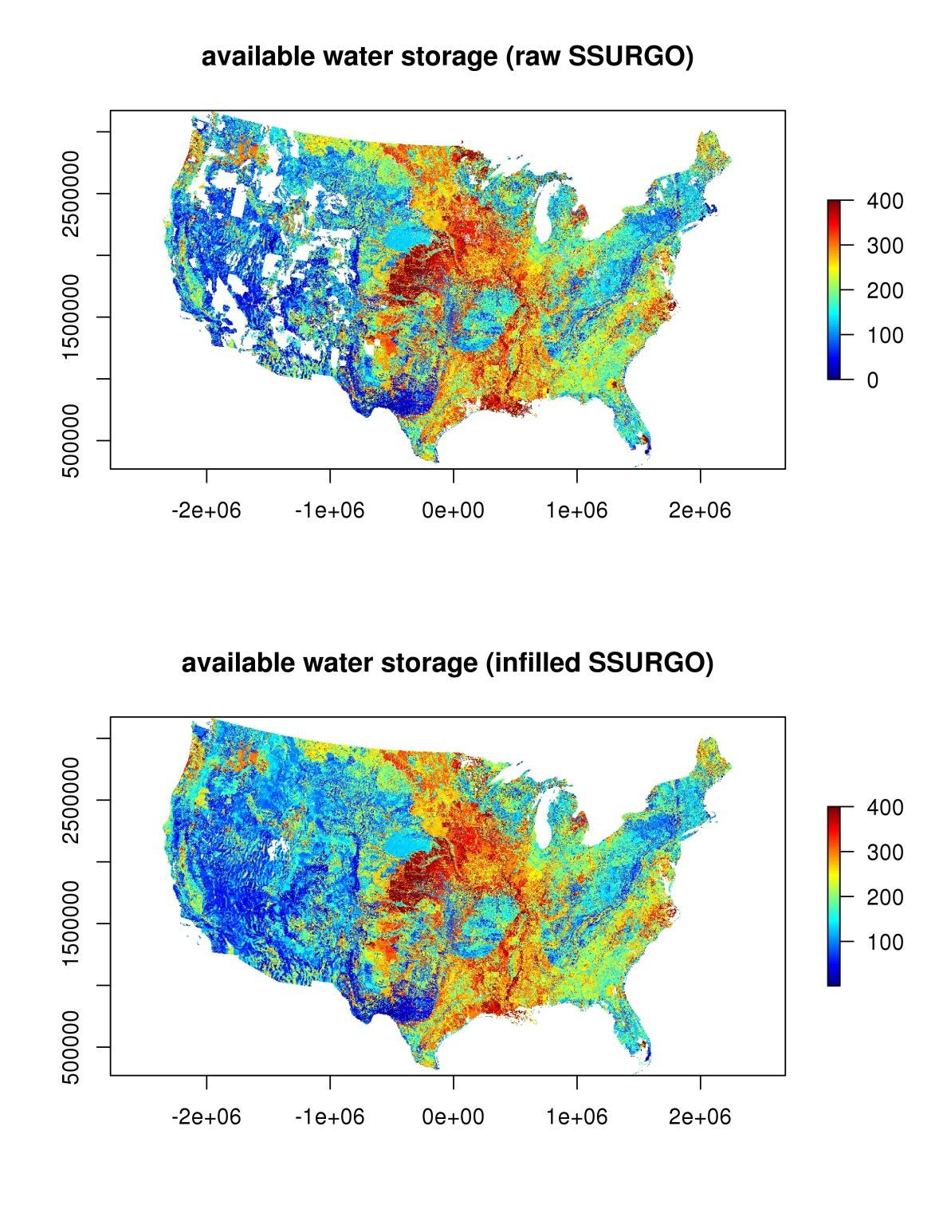
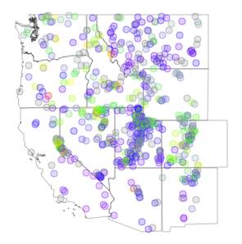
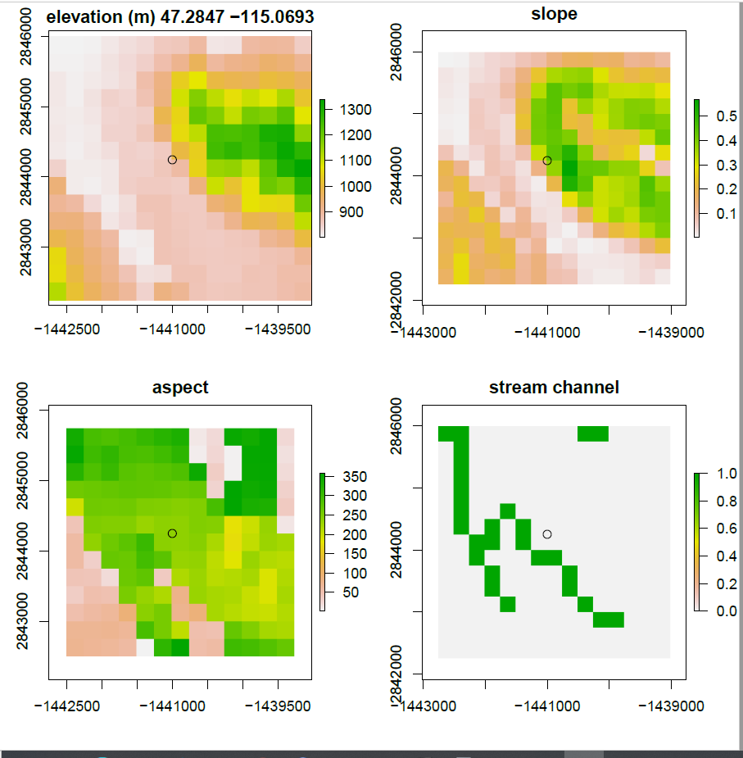
Ech2o model calibration and validation
MODEL INPUTS
-Calibrated to soil moisture
-Validation with MODIS surface temperature
Daily weather grids
SOIL TEMPERATURE VALIDATION
adj soils ECH20 model MODIS LST
650 soil moisture stations
Hourly point timeseries
≈
Raw gridded soils
SOIL MOISTURE CALIBRATION
ECH20 model Obs. soils
30m dem routing
NASA Sustainability Grant: Solomon Dobrowski, P.I. (2018-2021)

Slide 19
Ech2o skin temperature validation with MODIS
2,200 sites with < 5% canopy cover
2002-2018 (1.2 million obs)
Ech2o simulated soil surface temperature vs. MODIS LST
Zack Hoylman
U. Montana

Slide 20
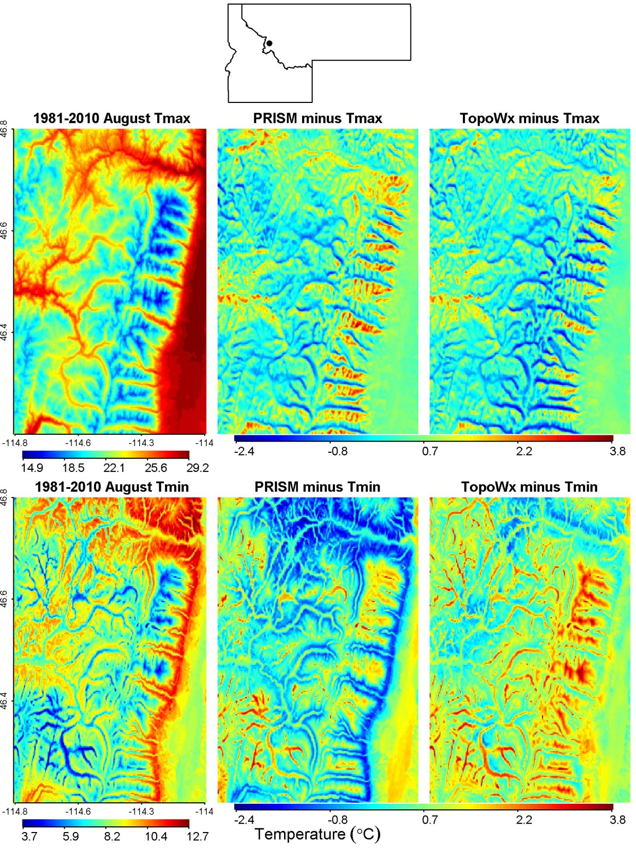
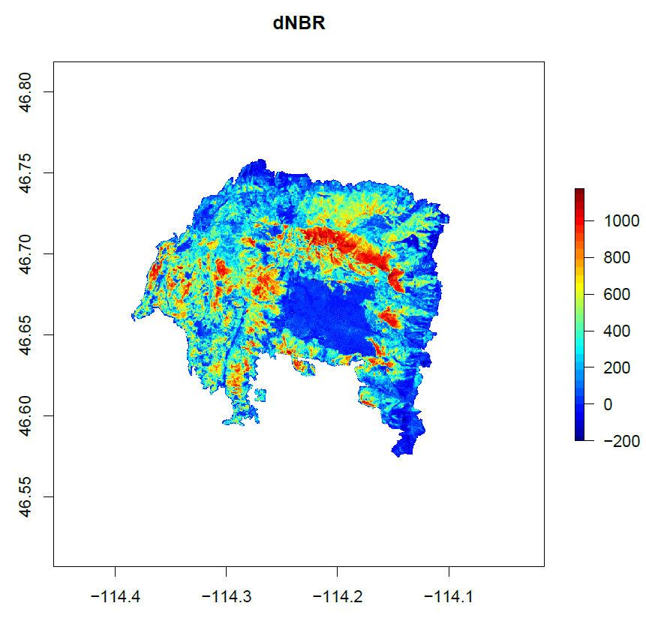
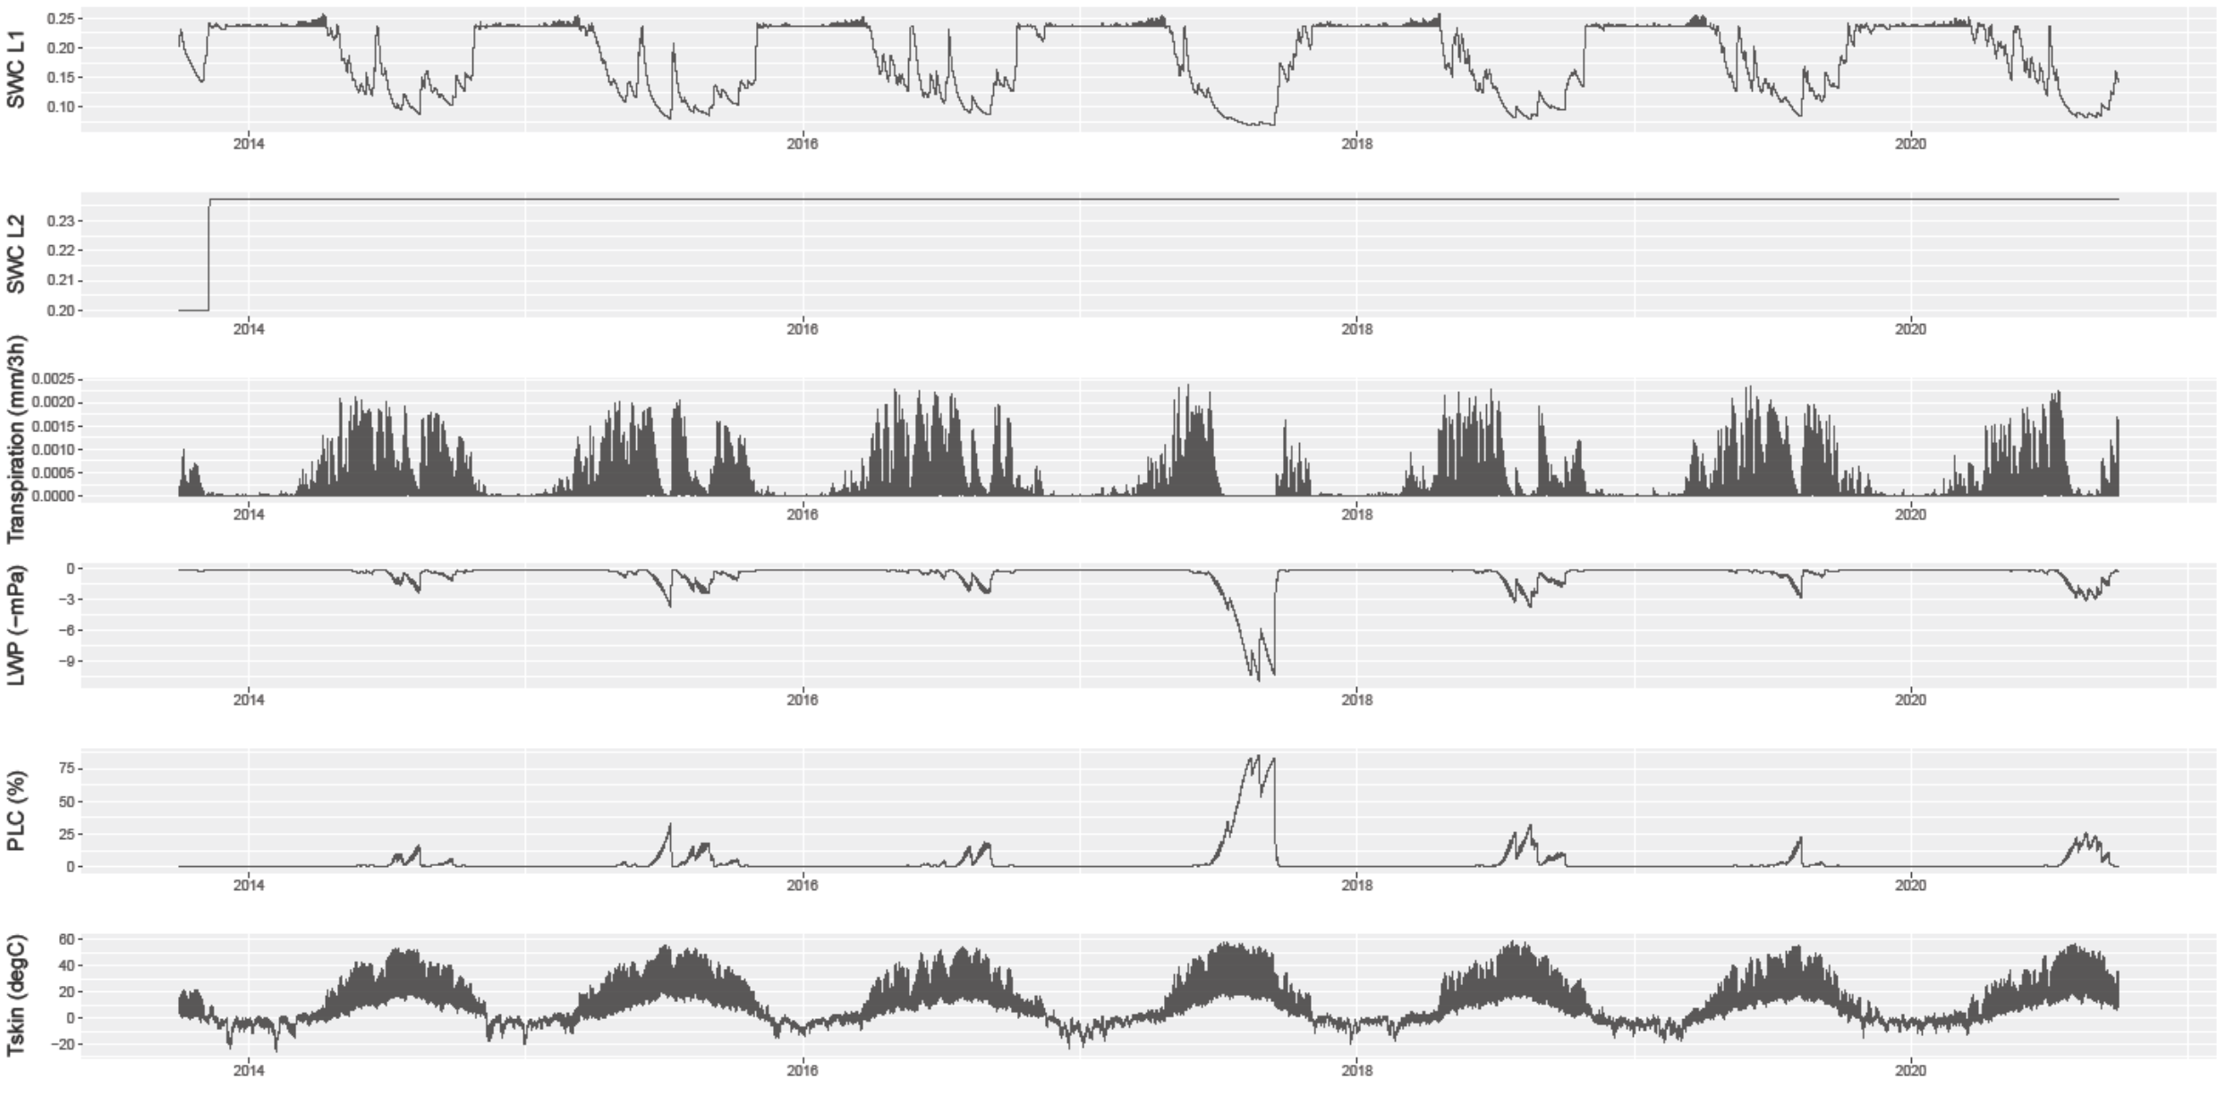
2017 Lolo Peak Fire, MT low elevation, south facing
Simulated soil moisture and plant hydraulic stress
DNBR

Slide 21
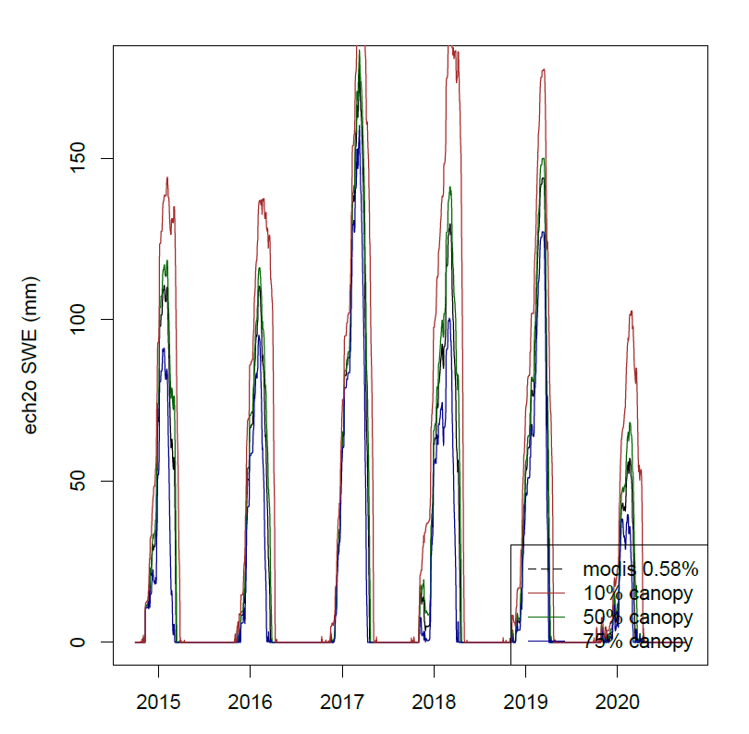
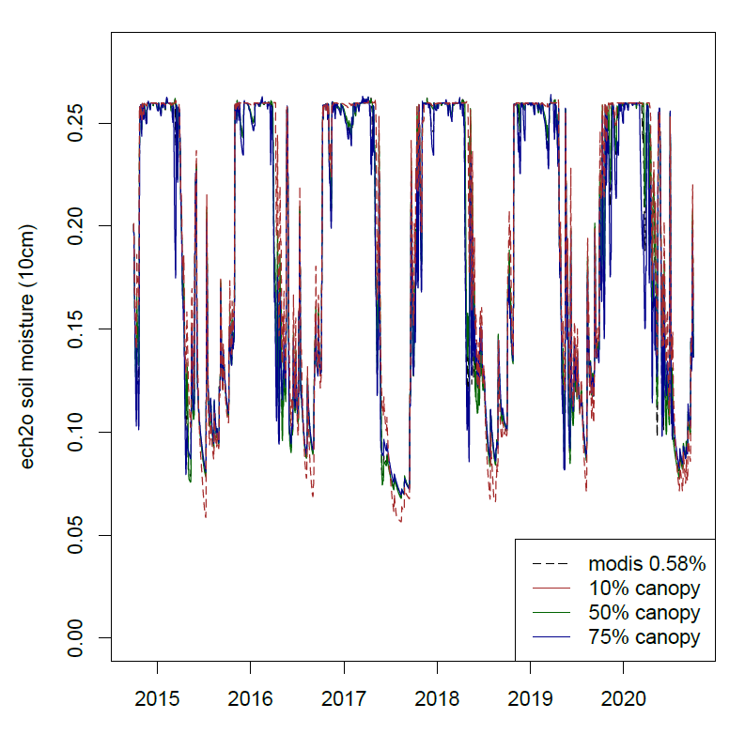
Vegetation effects on snow, soil moisture and surface temperature and interactions with terrain (i.e. topoclimate, microclimate)

Slide 22
Evaluating soil moisture as an indicator of fire danger and spread potential in the U.S. Northern Rocky Mountains
-Simple water balance, uniform veg,
No lateral flow
-Energy balance model, dynamic veg,
routing, bedrock leakance, etc.
Review Findings
Insufficient consideration of the impact of long-term drought on prescribed fire behavior.

Slide 23
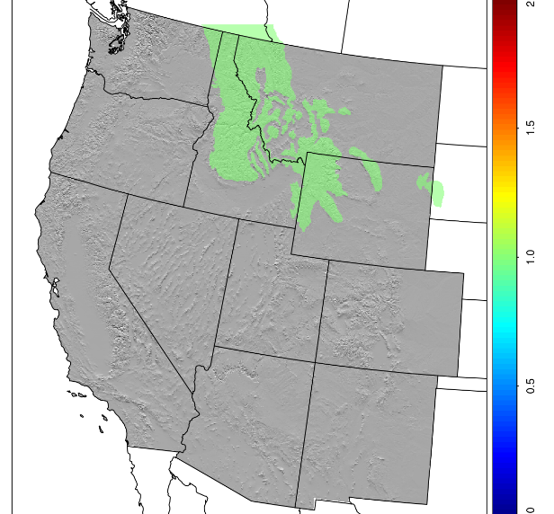
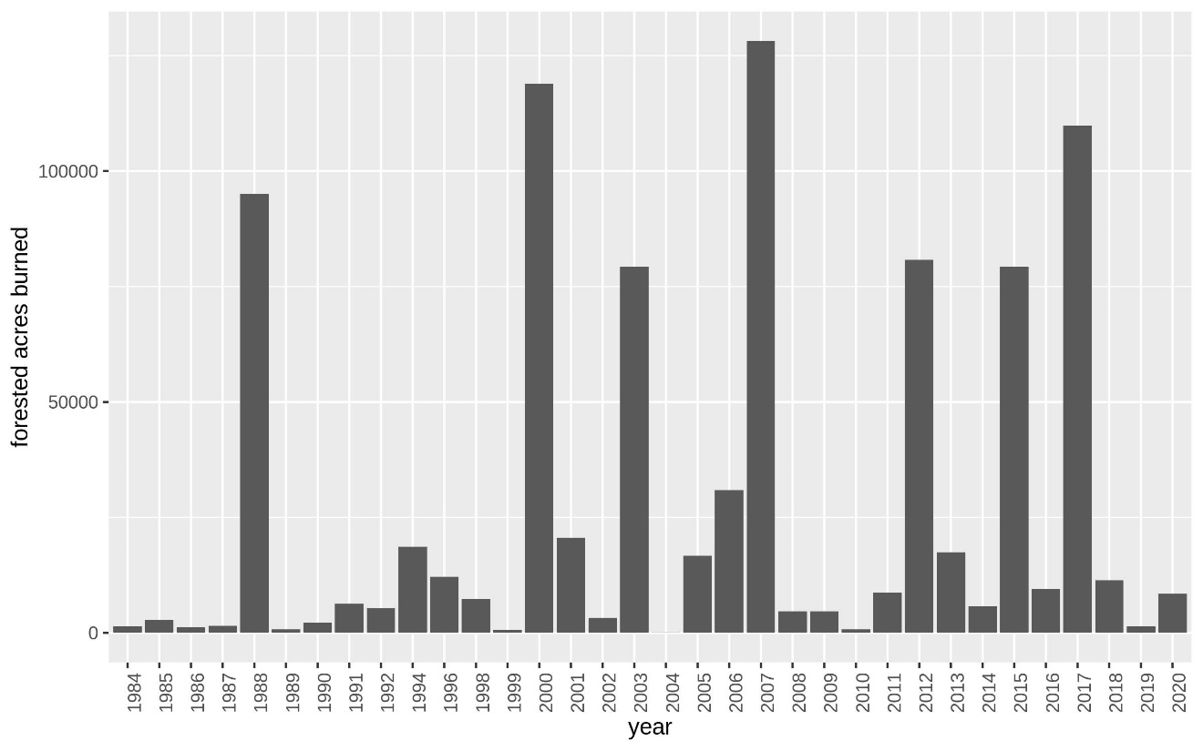
Annual forested area burned (1984-2020)

Slide 24
Annual forested area burned (1984-2020)

Slide 25
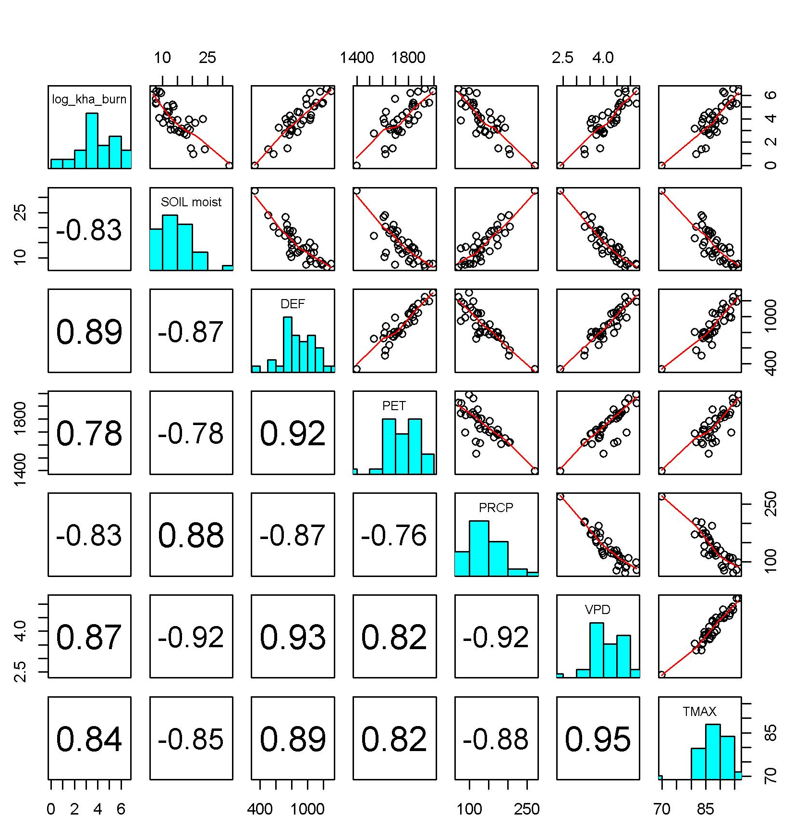
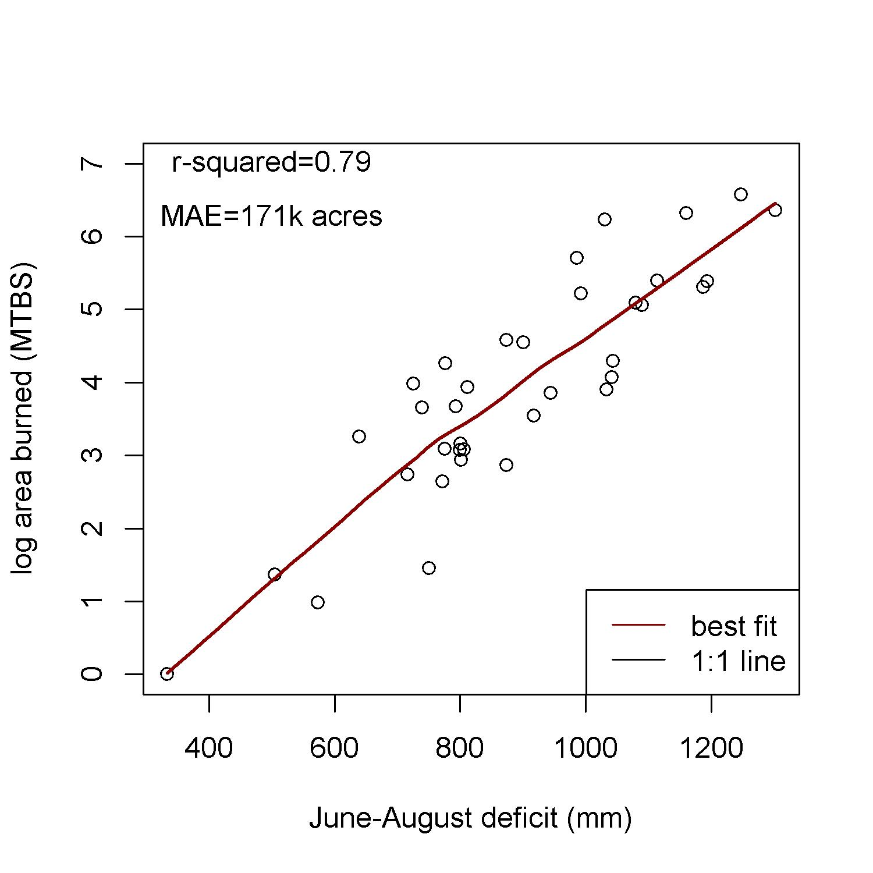
With hindsight, area burned is well predicted by weather data, models

Slide 26
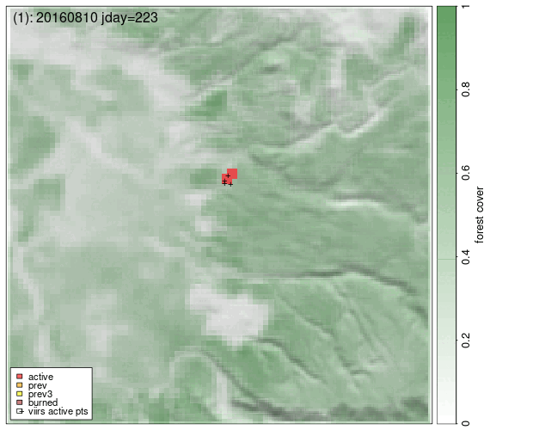
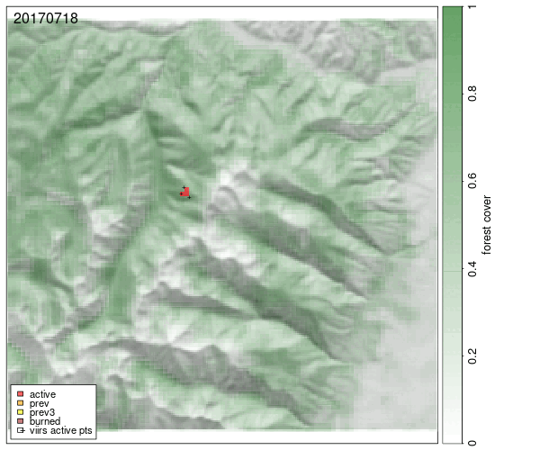
VIIRS satellite thermal fire detections; 375m 2x daily, 2012-present
spatial regression to estimate daily day of burn at 250m resolution
207 fires from 2012-2021
2017 Lolo Peak fire
2016 fire

Slide 27
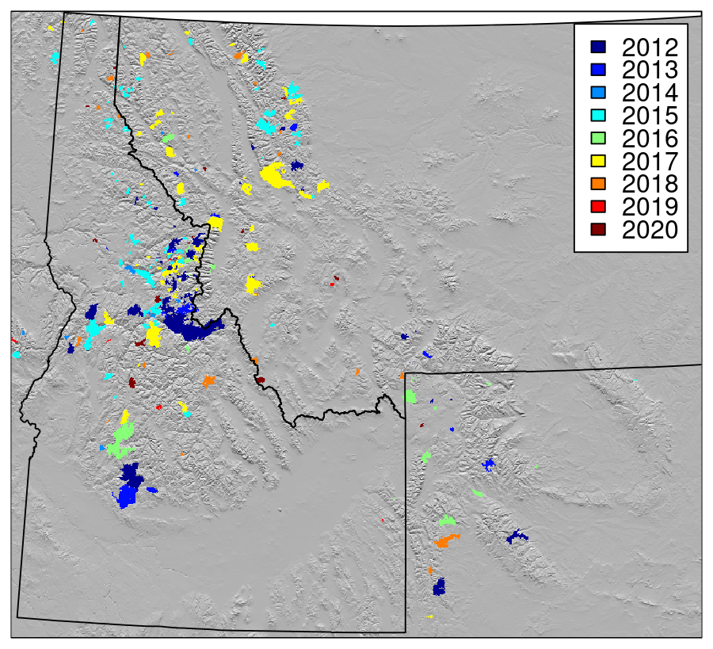
Daily weather, fuel and hydrologic predictors
- 25 variables extracted for daily burn footprint
- predictors grouped to limit autocorrelation
Water supply
Topofire soil moisture (raw, anomaly)
Ech2o Soil moisture, soil surface temperature, leaf water potential
ERC, 100 and 1000 hour fuel moisture
Atmospheric demand
Potential ET (PET), deficit (DEF), tmax, rhmin, VPDmax, solar radiation
Nocturnal humidity
Tmin, Rhmax, VPDmin, Dewpoint temperature
Wind speed variables
Hourly Real time mesocscale analysis (RTMA) 2.5 km resolution(mean, max, 95th ptile)
Climate Forecast System Reanalysis (CFSR) 35 km resolution
Nearest RAWS station wind
Vegetation/Fuels: Forest, Grass, Shrub fractions from RAP
207 Fires

Slide 28
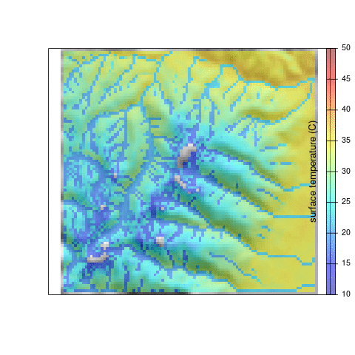
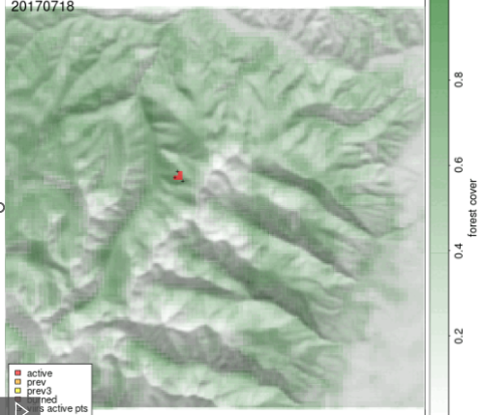
5 year ech2o simulations for each fire
Rangeland Analysis Platform (RAP) canopy cover (Allred et al. 2021)

Slide 29
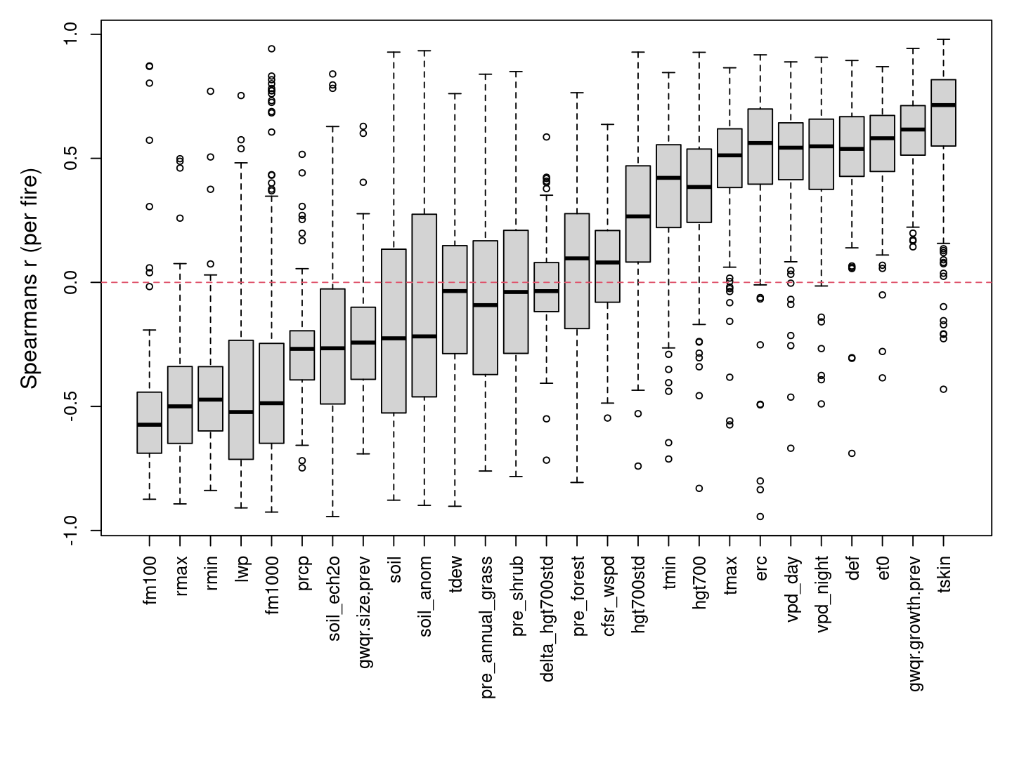
Per-fire correlations between daily spread and weather, hydroclimate

Slide 30
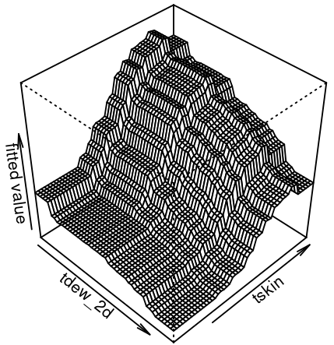
Boosted regression tree model results
- 260,000 candidate models, only variable per group
- full models vs. easily operational
variable names | Nvar | R-squared | MAE
Full model - all variables
TSKIN + LWP + TSKIN + forest-cover + ERC + TDEW + AtmPress | 6 | 0.464 | 0.678
TSKIN + LWP + forest-cover + ERC + TDEW | 5 | 0.461 | 0.683
TSKIN + forest_cover + ERC + TDEW | 4 | 0.454 | 0.688
operational model - Ech2o and fuel moisture variables excluded
SOIL_anom + DEFICIT +VPD_night + forest-cover + AtmosPress | 5 | 0.345 | 0.777
SOIL_anom + forest-cover+ Rhmin + TMIN | 4 | 0.344 | 0.793

Slide 31
Key results from fire spread modeling
Simulated surface temperature and LWP strongest predictors
Energy balance models contribute significant information
Hydraulic stress slightly better predictor than soil moisture
Wind effects negligible
nighttime humidity consistent strong predictor
(Balch et al. 2022; Freeborn, Jolly et al. 2022)

Slide 32
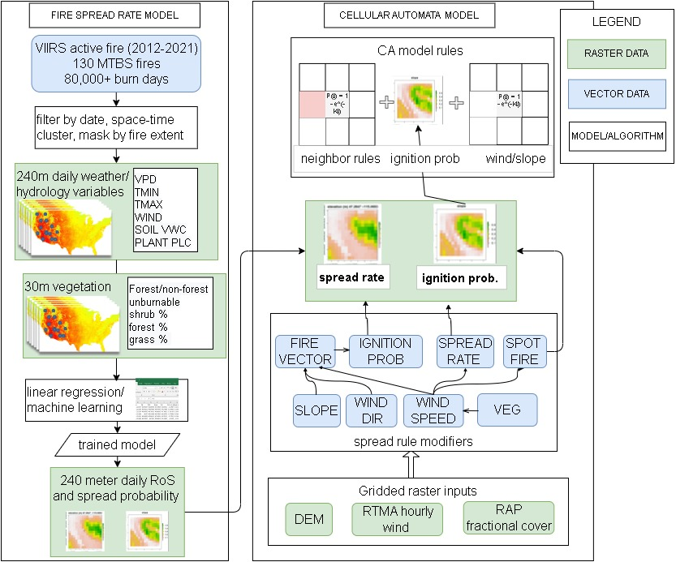
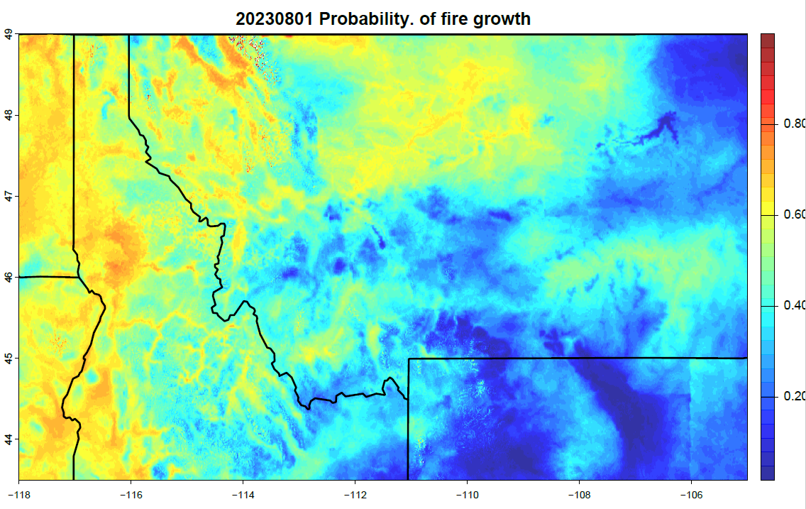
Operational mapping for Region 1 https://topofire.dbs.umt.edu/public_data/R1_fire
Erin Noonan, R1 fire analyst
1-3 day forecast maps
-fire growth probability
- predicted acres growth
- soil moisture
- wind speed
- surface weather

Slide 33
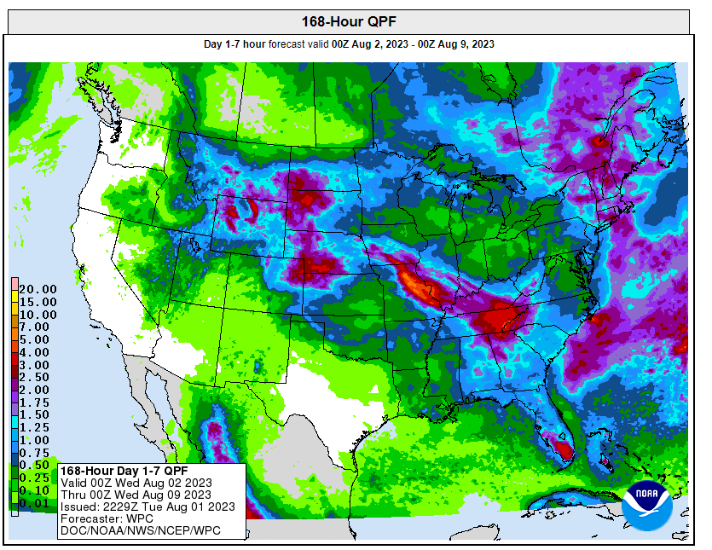
Hurricane Dora
Major precipitation event August 1st-6th
.25-5 inches of rain across the N. Rockies

Slide 34
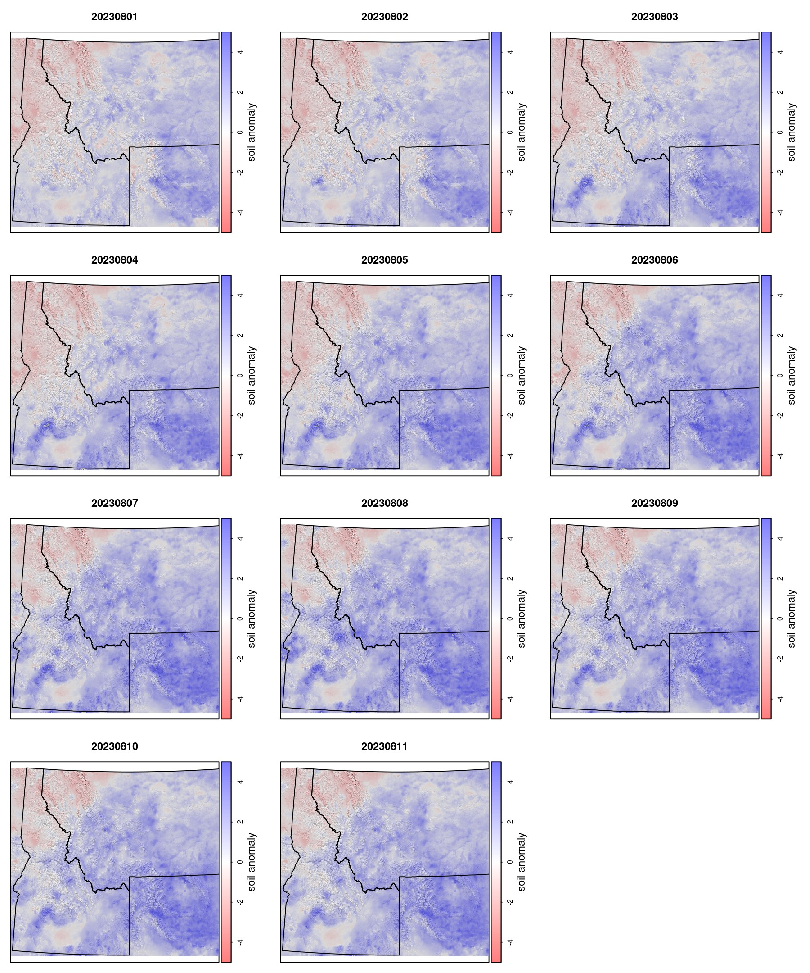
Soil moisture anomaly response to precipitation

Slide 35
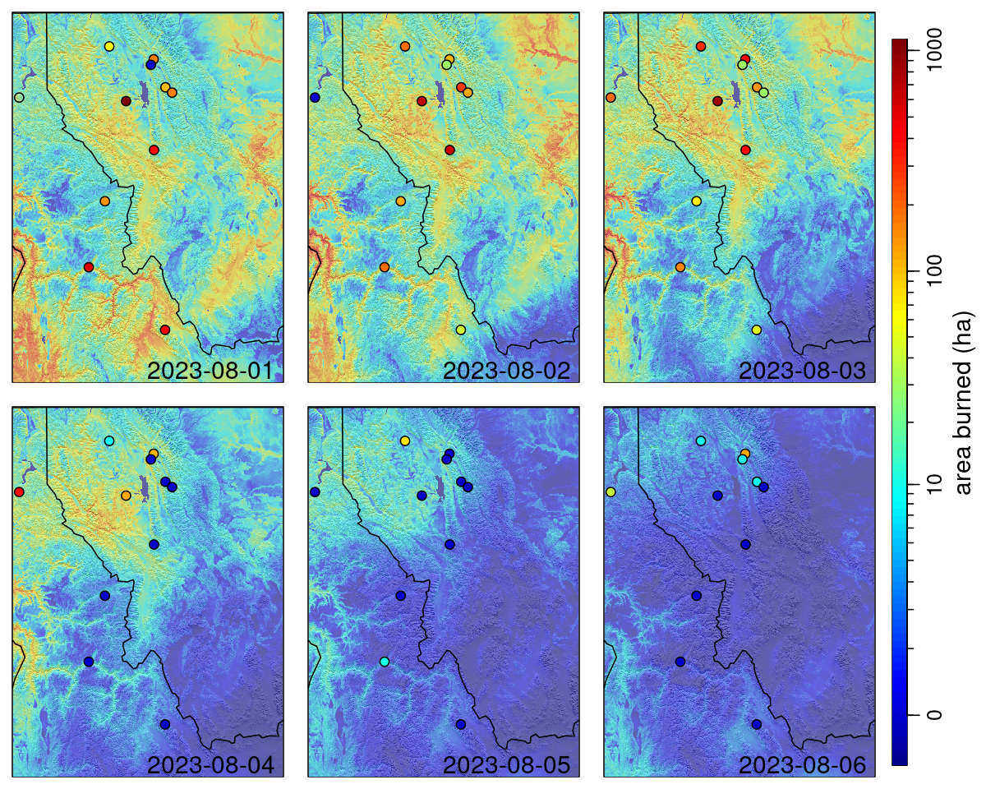
Active VIIRS fires
August 1st-6th 2023
Daily potential area burned predictions

Slide 36

Where are we going?

Slide 37
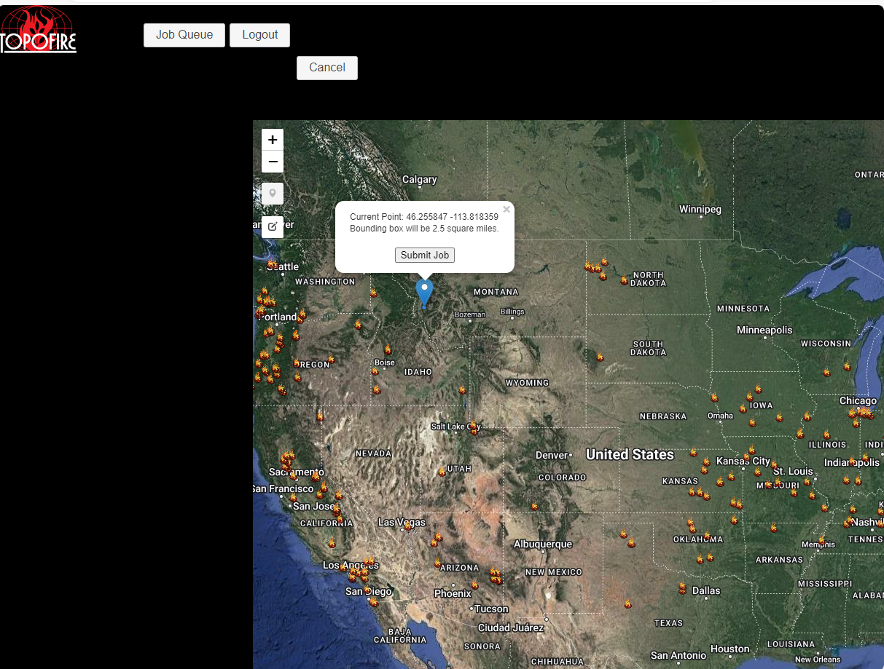
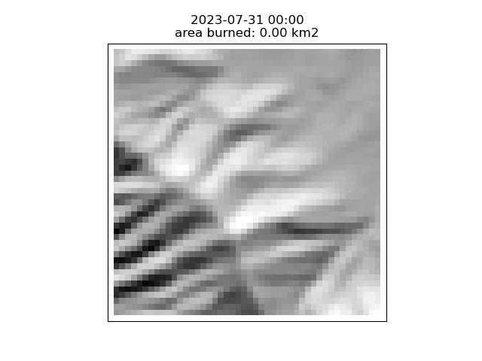


Web-based fire spread forecasting tool
https://topofire.dbs.umt.edu/firespread_jobs/firespread_modeling
Adam Viray
Erin Landguth

Slide 38
Ensemble model forecasts?
On demand fire spread predictions
1-3 day hourly wind, weather, soil moisture forecasts
Bipartisan Infrastructure proposal to develop system for Rx burn and planning
Add ensemble physics based models
-QES-fire (M. Moody), QUIC-fire, others?

Slide 39
post-fire reforestation in the western United States
Zack Holden – USFS Region 1
Allen Warren – U. Montana
Ellen Jungck – USFS Region 1
Alan Swanson– U. Montana
Marco Maneta – U.Montana
Kim Davis – U.Montana
Vince Archer – USFS Region 1
Shelagh Fox – USFS Region 1
Nicole Ballofet- USFS, Washington DC
Lolo Peak fire, July-August 2017

Slide 40
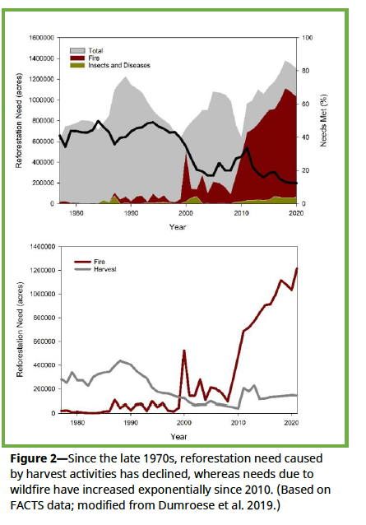
post-fire reforestation in the western United States
Ballofet and Dumroese 2022
Forest Activities database (FACTS)
Massive increase in unmet reforestation needs due to wildfires

Slide 41
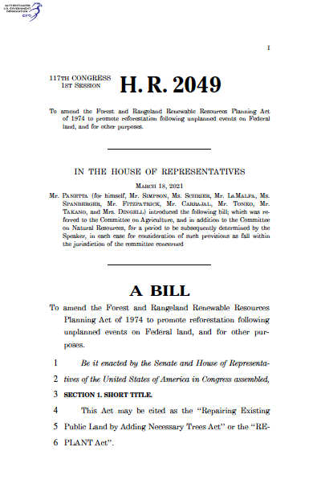
REPLANT act mandates addressing reforestation backlog over next decade
Removes cap on reforestation trust fund and increases annual funding from $30mil to $140 mil or more.
Once in a generation opportunity to shape future forests

Slide 42
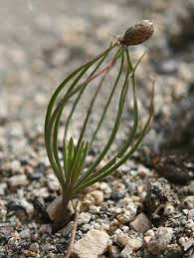
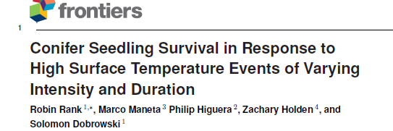
Surface temperature as biophysical constraint on low elevation tree line
brief exposure to temperatures of 55 °C can kill conifer seedlings
Cambial damage and girdling;
lose ability to move water from soil to atmosphere

Slide 43
30 meter surface temperature mapping
75,000 random stratified points
Spatial domain around each point to allow lateral water flow
Ech2o run hourly from 1982-2018
Calculate climatological average annual maximum skin temperature at each point
Geographically weighted regression used to fit/predict across western U.S.
Computational resources and support from the University of Montana’s Griz Shared Computing Cluster (GSCC)

Slide 44
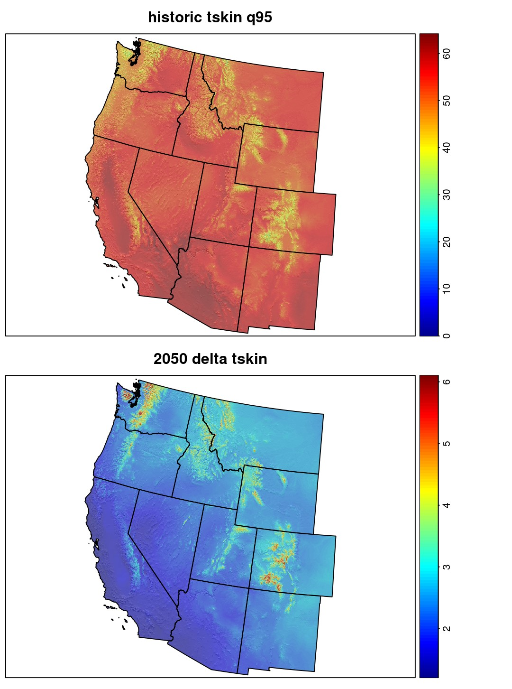
Potential soil surface temperature (PSST)
-95th percentile maximum annual soil surface temperature for a bed of 2 inch ponderosa pine seedlings
30 meter resolution raster
- historical (1982-2018)
- future (2050) from CMIP6 ensembles
Holden et al. (in review)

Slide 45
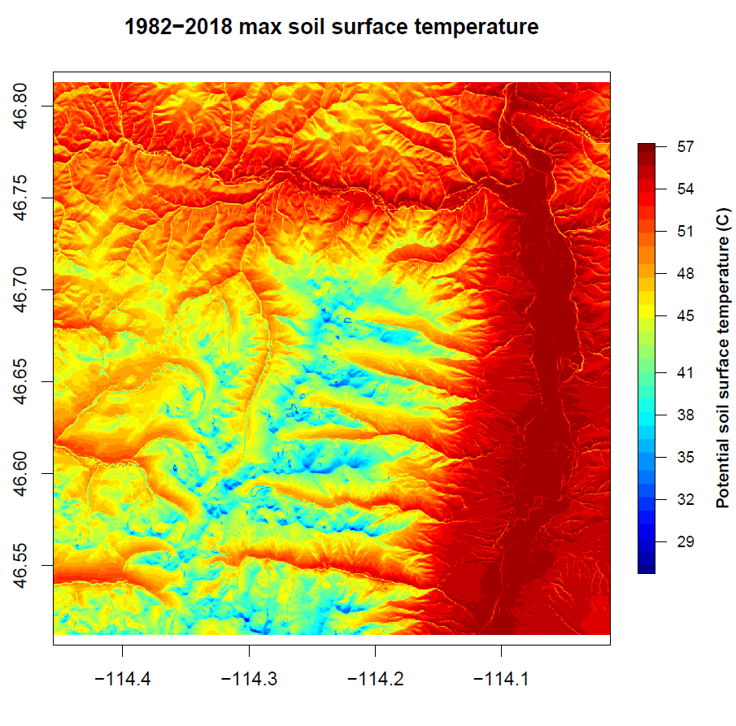
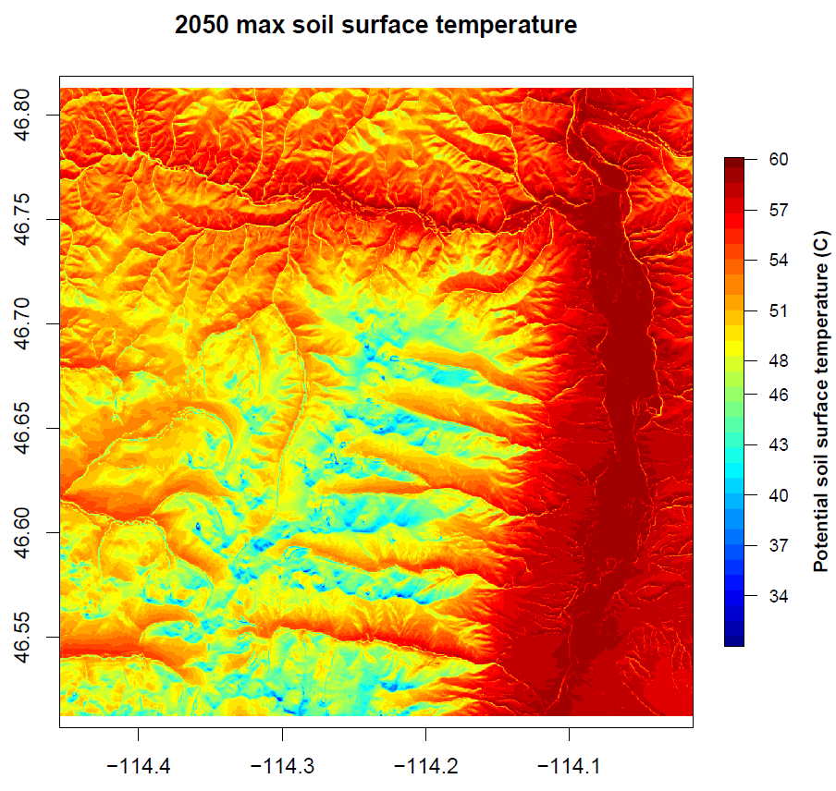

Slide 46

https://orthanc.dbs.umt.edu/regenmapper

Slide 47
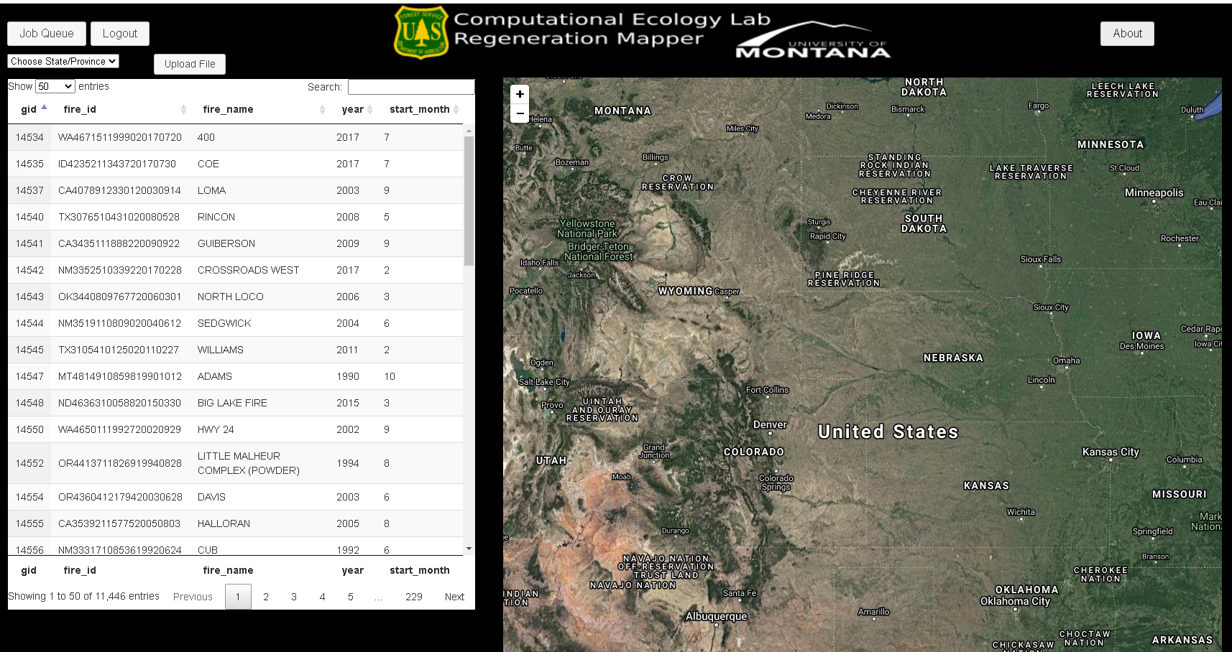

Slide 48


Slide 49




Simple automated GIS
Fitted regression models from 2 datasets
- any species prediction
- individual species models for:
PIPO, PSME, PICO, PIEN, ABLA, ABGR
Kim Davis , RMRS Fire lab
Kim Davis Lewis Faller
10,000+ plots from 330 wildfires
89 plots, 32 fires; annual recruitment date

Slide 50

post-fire recruitment model for any species
Full model includes distance to seed from GEDI LiDAR
Climate-only effect model
Dispersal only effect model
Binary outcome (yes, no)
Projected 2050 regeneration probability based on CMIP6 ensemble

Slide 51

Administrative priorities for USFS
Planting logic applied to raster
Highest priority with pre-existing FACTS need
Different classification for wilderness, roadless or specially designated area
Planting versus natural regeneration determined using modeled regeneration probability

Slide 52

Distance to nearest road
calculated for every severely burned pixel
30 meter raster output

Slide 53

Planting prioritization/optimization

Slide 54
Where are we going?

Slide 55

- USDA Agriculture and Forest Research Initiative (AFRI)
- 3 year grant; 2022-2024 $695,000
“Quantitative prediction and prioritization for reforestation success: Development of an automated decision support tool for the USDA Forest Service”
Further develop cost-benefit prioritization
Potential links to ForSys model (Mark Finney, Michelle Day)
Kim Davis Lewis Faller
Marco Maneta
Solomon Dobrowski Erin Landguth
Allen Warren
Alan Swanson

Slide 56

Web-based ech2o model
On demand point or watershed simulations
Ask questions about post-harvest water and energy
USFS Region 1 funding (Vince Archer, Andy Efta)

Slide 57

Web-based ech2o model
On demand point or watershed simulations
Ask questions about post-harvest water and energy

Slide 58


North Superior project (Carli Anaballi)
public comments on post-harvest regen

Slide 59


Thank you
Funding
NASA
NOAA/NIDIS
USFS Region 1
Computing
U. Montana Griz Cluster
NASA HPC
NSF-Stampede
Many collaborators

